Slide 1
LECTURE 04: PERCEPTION AND COLOR
October 4, 2016
SDS 136
Communicating with Data
Portions of this slide deck adapted from K. Verbert at U. Brussels

Slide 2
Announcements
A1 feedback will be posted to Moodle this evening
A2 due date on Moodle was incorrect: due THURSDAY
Jordan’s Wednesday PM office hours in Burton 209 will start at 5pm this week (30 minutes later than usual)

Slide 3
Outline
What is perception?
How does it work?
Pre-attentive processing
Perceptual problems
Estimating magnitude
Color 101
How we see color
What this means for visualization
More perceptual problems
Takeaways

Slide 4
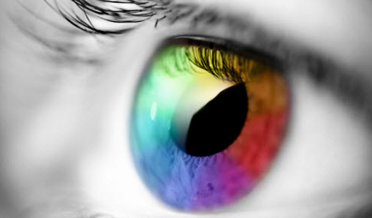
What is perception?

Slide 5
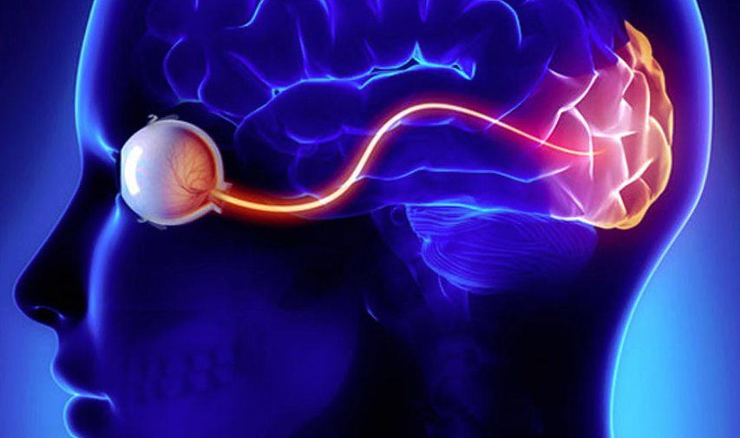
Visual perception (def.)
the (sometimes imperfect)
process by which we
detect and interpret
visual signals

Slide 6
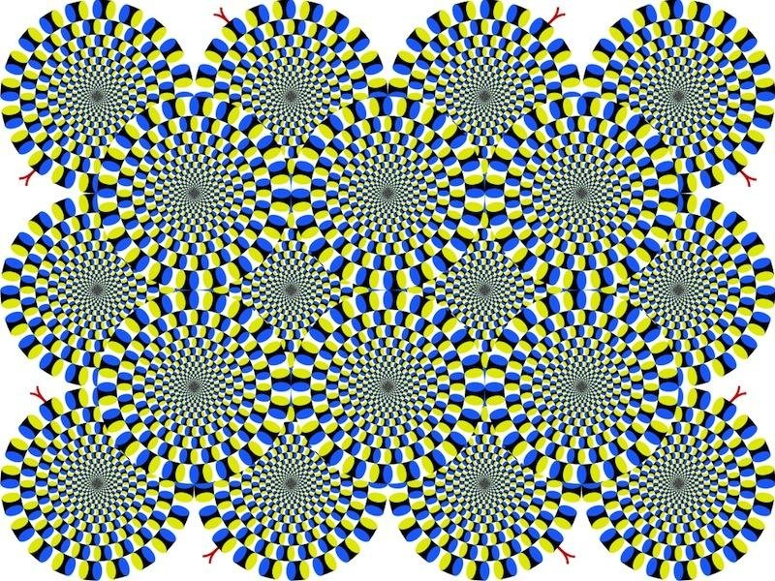

Slide 7
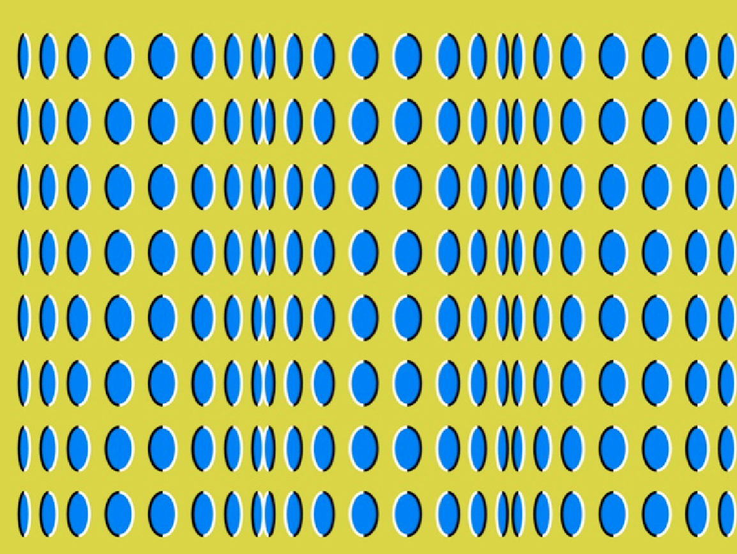

Slide 8
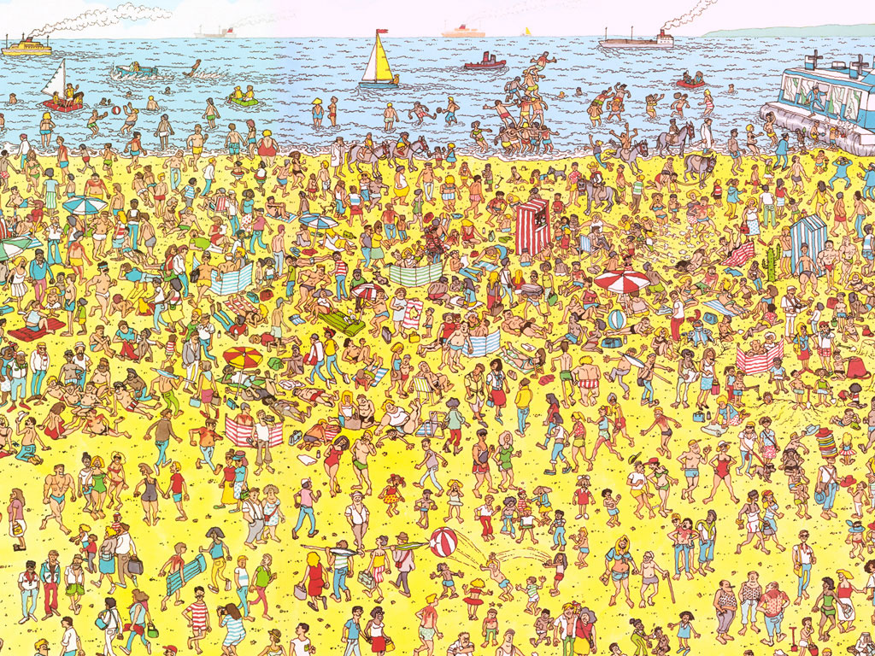
Some things are processed slowly

Slide 9
Others are incredibly fast

Slide 10
Fast = “pre-attentive processing”
Things that happen in <200ms of visual stimulation
Performed in parallel across the entire visual field
Example:

Slide 11
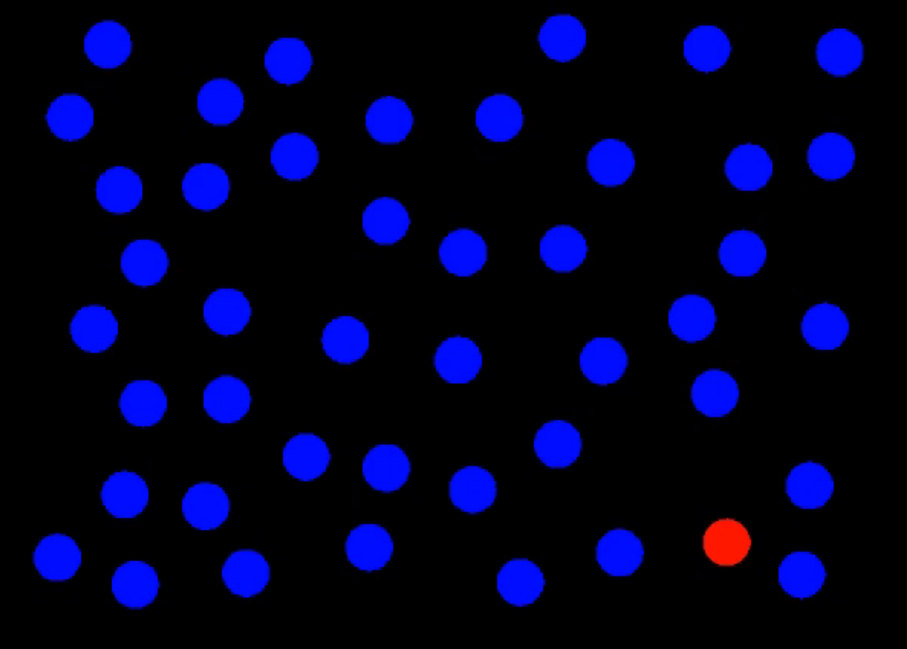
Perception: Preattentive Processing

Slide 12
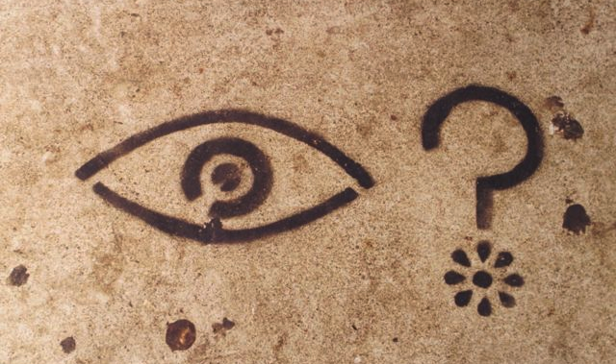
What did you see?
Notes:
Clocked my spacebar double-tap ability at about 80ms on average.
Without knowing what you were going to see, you likely attuned to the red dot in the field of blue dots.
This is the power of preattentive processing.

Slide 13
Pre-attentive processing
“An understanding of what is processed pre-attentively is probably the most important contribution that visual science can make to data visualization” (Ware, 2004, p. 19)

Slide 14
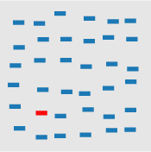



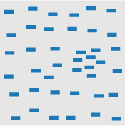

Pre-attentive features (1/2)
color (hue)
intensity
size
orientation
clustering
length
http://www.csc.ncsu.edu/faculty/healey/PP/

Slide 15


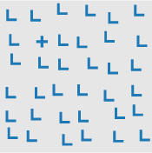
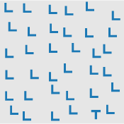
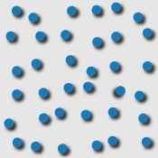
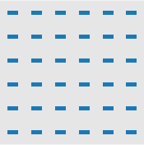
Pre-attentive features (2/2)
curvature
closure
intersection
termination
lighting direction
flicker
http://www.csc.ncsu.edu/faculty/healey/PP/

Slide 16
Pre-attentive processing facilitates:
Target detection (presence or absence)
Boundary detection / grouping
Region tracking
Counting and estimation
Notes:
Now I’m going to flash an image on the screen

Slide 17
Attentive counting
1281768756138976546984506985604982826762
9809858458224509856458945098450980943585
9091030209905959595772564675050678904567
8845789809821677654876364908560912949686
How many threes are there?

Slide 18
Pre-attentive counting
1281768756138976546984506985604982826762
9809858458224509856458945098450980943585
9091030209905959595772564675050678904567
8845789809821677654876364908560912949686
How many threes are there?

Slide 19

Pre-attentive processing for visualization
Question 1: how do we (vis designers) use pre-attentive processing to our advantage?
Question 2: what do we need to watch out for?

Slide 20
Pre-attentive processing: color (hue)

Slide 21
Pre-attentive processing: shape (curvature)

Slide 22
Pre-attentive processing: shape + color?

Slide 23
Discussion: what’s going on here?
Answer: this is called “conjunction”
If you search for red things, you get a bunch of red circles (as well as the red triangle).
Similarly, if you search for search for triangles, you get a bunch of blue triangles (as well as the red triangle).
Either way, you have to search through them all one by one!

Slide 24
Pre-attentive processing for visualization
Whatever draws our eyes draws our attention
This can be useful
It can also be problematic:

Slide 25

Ex. flicker can cause change blindness

Slide 26


Can you see it now?
Notes:
Not only is this comparison easier, but if we now go back to the original flickering image, you won’t have the same problem – you can’t “unsee” the answer.

Slide 27
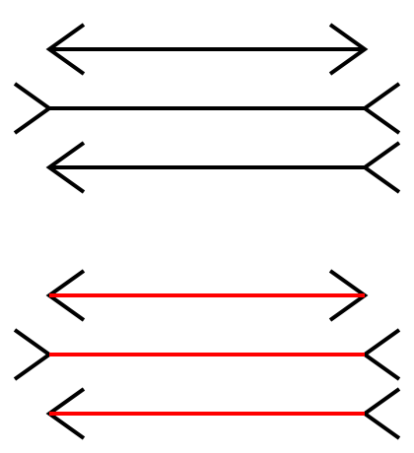
Sometimes gestalt & pre-attention compete

Slide 28

Sometimes gestalt & pre-attention compete

Slide 29

Okay, what about attentive processing?

Slide 30
Magnitude estimation
Question: How much bigger is the lower bar?
Answer: 2x

Slide 31
Magnitude estimation
Question: How much bigger is the right square?
Answer: 4x

Slide 32
Magnitude estimation
Question: How much bigger is the left cube?
Answer: 27x

Slide 33
“Apparent” magnitude
Length
estimate
correctly
Area
under-
estimate
Actual
perfect correspondence
Volume
way under-
estimate
Perceived
http://makingmaps.net/2007/08/28/perceptual-scaling-of-map-symbols/

Slide 34
Mapping to visual dimensions
 | Perceived as similar | Perceived as different, forming families | Perceived as ordered | Perceived as proportional
SIZE | ?
VALUE | ?
COLOR |  |  | ?
SHAPE
ORIENTATION

Slide 35

Color 101

Slide 36
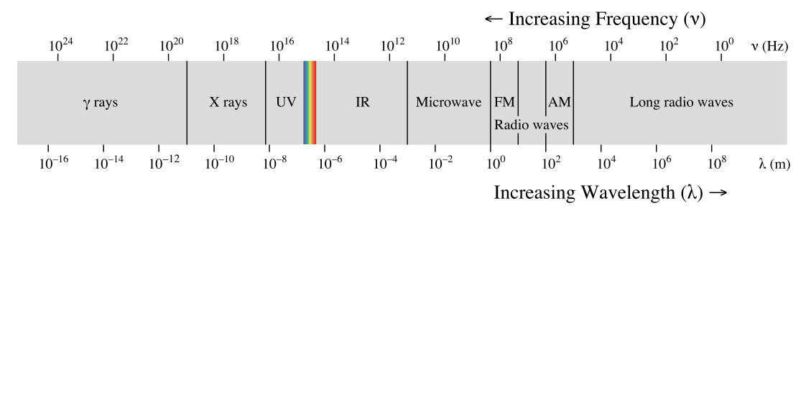
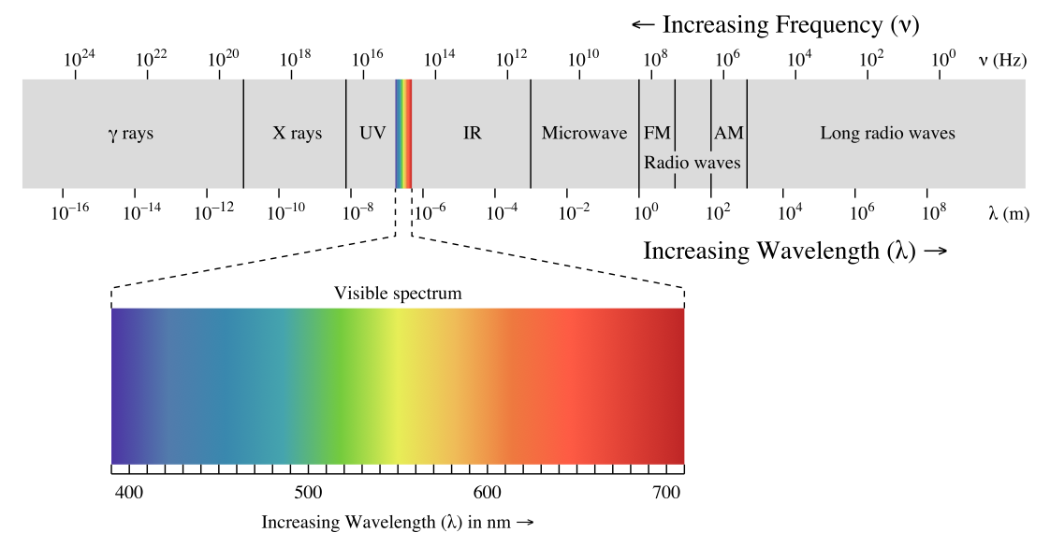

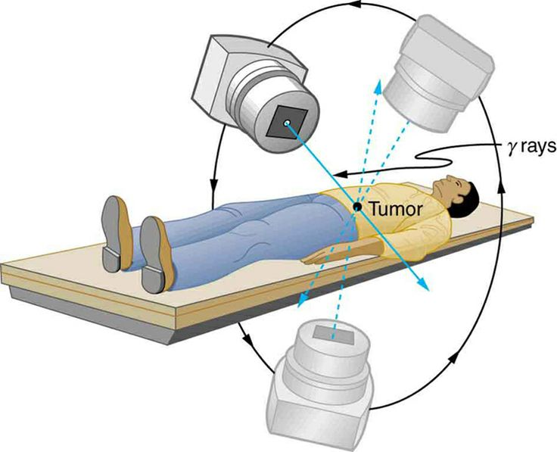
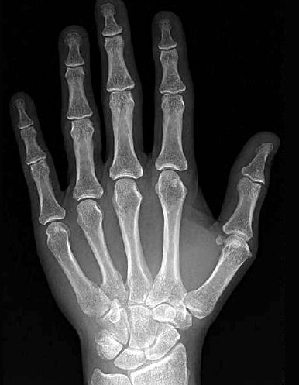

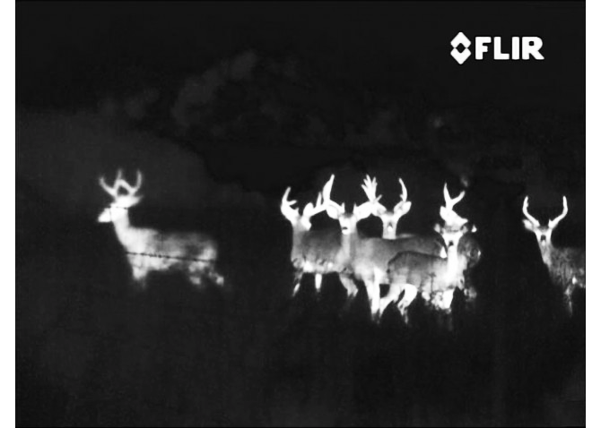
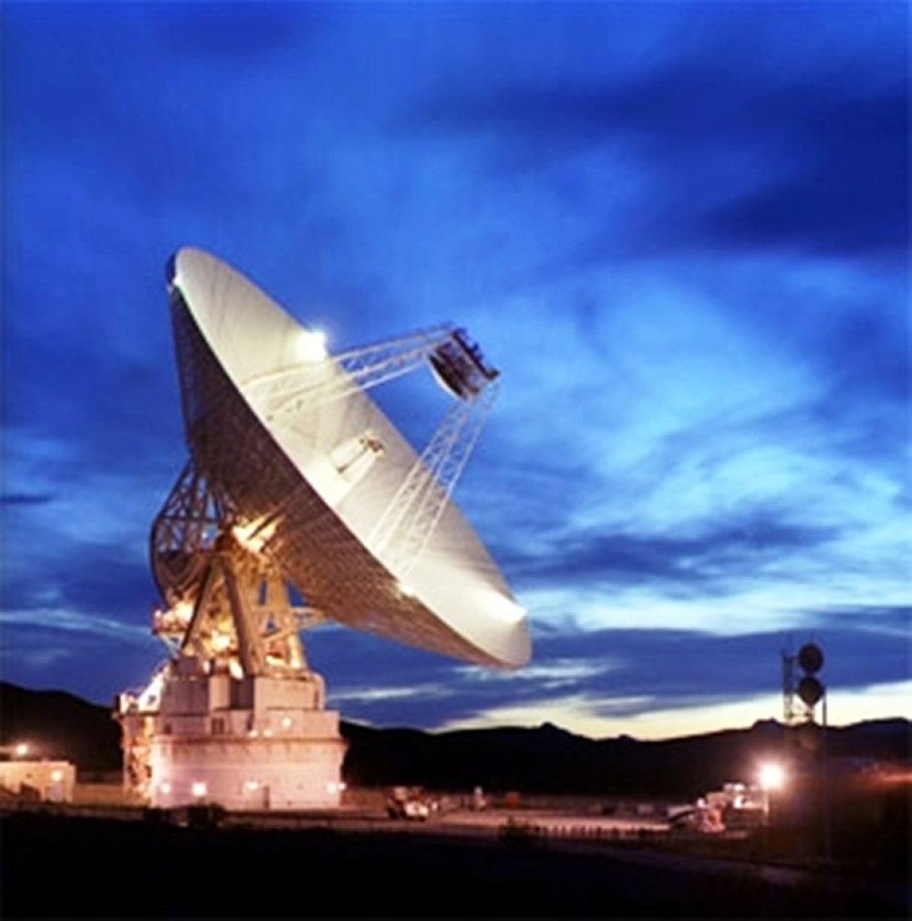
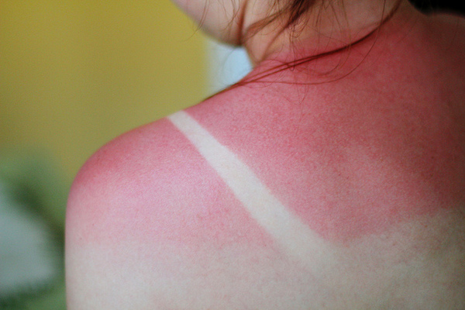
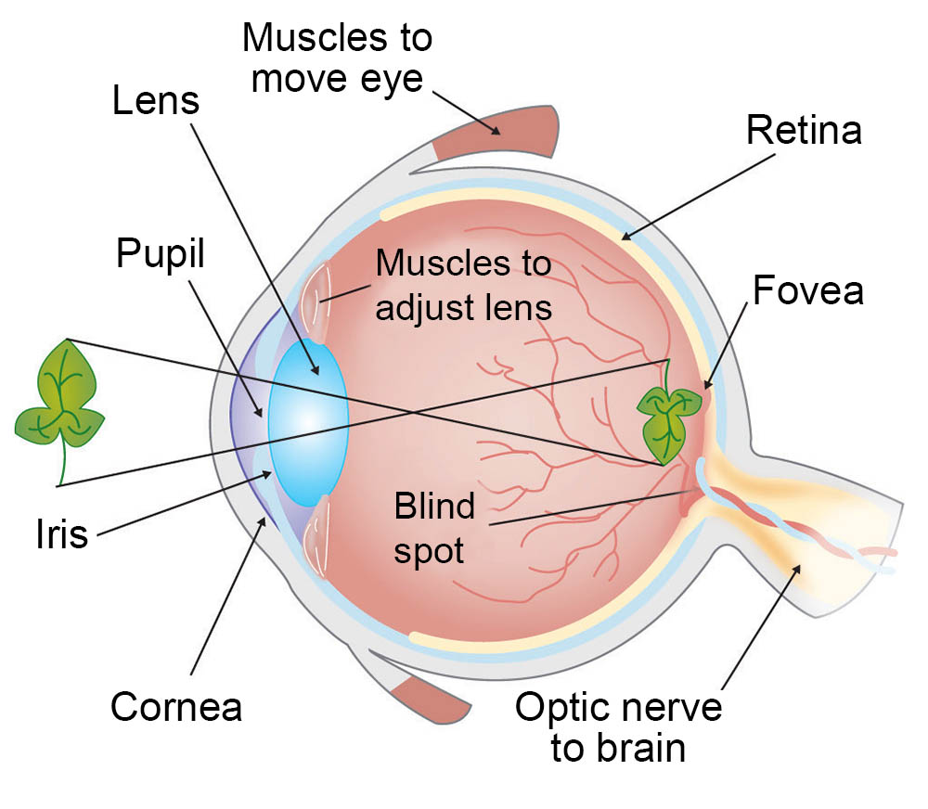
Kinds of light
Eye diagram courtesy ASU

Slide 37

How we see color

Slide 38
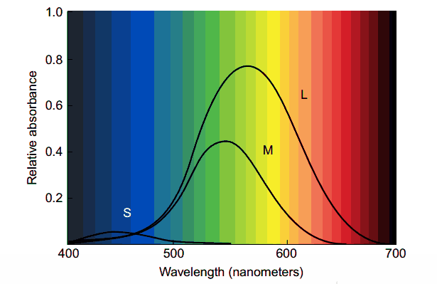
3 kinds of color sensors

Slide 39
Discussion: what do you notice?

Slide 40
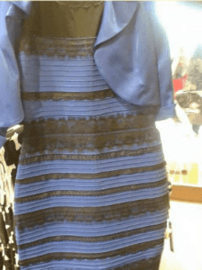

Color phenomena

Slide 41
Caveat 1: color is perceived in context
Which small square is darker green?

Slide 42


Caveat 2: difference is relative

Slide 43

Caveat 2a: so are brightness and contrast

Slide 44
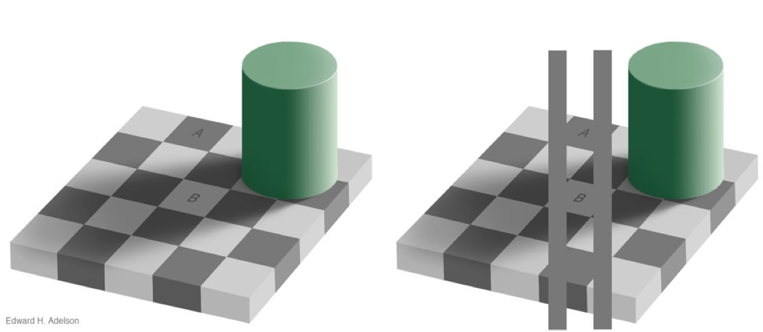
Caveat 3: mental models > perception

Slide 45
Takeaways: Perception
Visualization is about more than just aesthetics
There are compelling cognitive reasons why some visualization techniques are helpful and others aren’t
The choices we make about visual mappings can have a significant effect on performance

Slide 46
Mini-lab: perceptual tricks
Find a partner and open Tableau
Open a dataset of your choosing
Build two visualizations on this dataset
One that tells the “real” story in the data (as you understand it)
One that uses color, size, or other cues in an intentionally misleading way

Slide 47
Discussion
What did you try?
What did you learn about the data?
Can you imagine a scenario that might incline someone to choose your “bad” visualization instead of a better one?

Slide 48

Coming up
Thursday – more on
Assignment 2 due on Thursday Oct. 4th by 11:59pm

